Slide 1
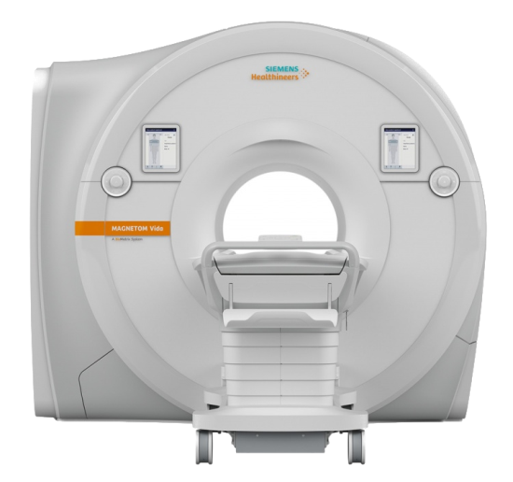
A clinical and research 3T MRI protocol under 30 minutes
(Yes, it’s possible!)
SK Larroque, M Carrière, C Martial, S Laureys
github.com/LRQ3000/mri_protocol
V1.0.5
Coma Science Group GIGA Consciousness
University & Hospital of Liège, Belgium
CME 2019
Dortmund, September 23th 2019
Notes:
MRI = magnetic resonance imagery

Slide 2
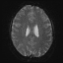
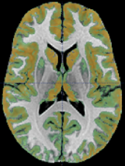
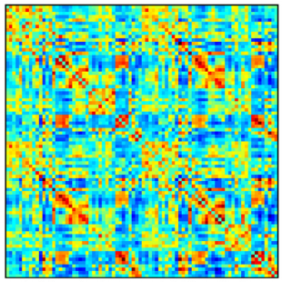
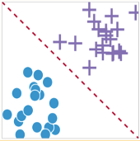
What we do: MRI analyses
Preprocessing
(SPM12)
fMRI timeseries
(one per subject)
Analysis
(CONN)
Machine learning
(SVM)
[1] Demertzi, Antonopoulos et al, Brain, 2015
Notes:
Before talking about acquisition, let’s talk a bit about analysis. I promise there is a link, because that’s how I came to work on this new MRI protocol. So, you see, I am an analyst, I was educated to do analyses, so that’s what I usually do. Let’s quickly see how it works: a common framework for MRI analysis is as follows: you start with a bunch of fMRI timeseries, one per subject, then you preprocess them, then analysis to get connectivity matrices, and then maybe to add a bit of magic you use machine learning.

Slide 3
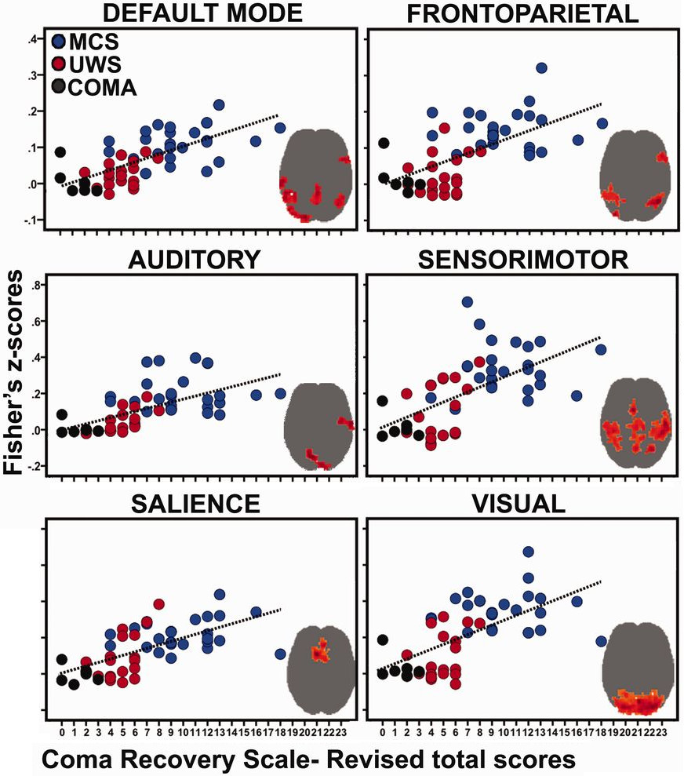
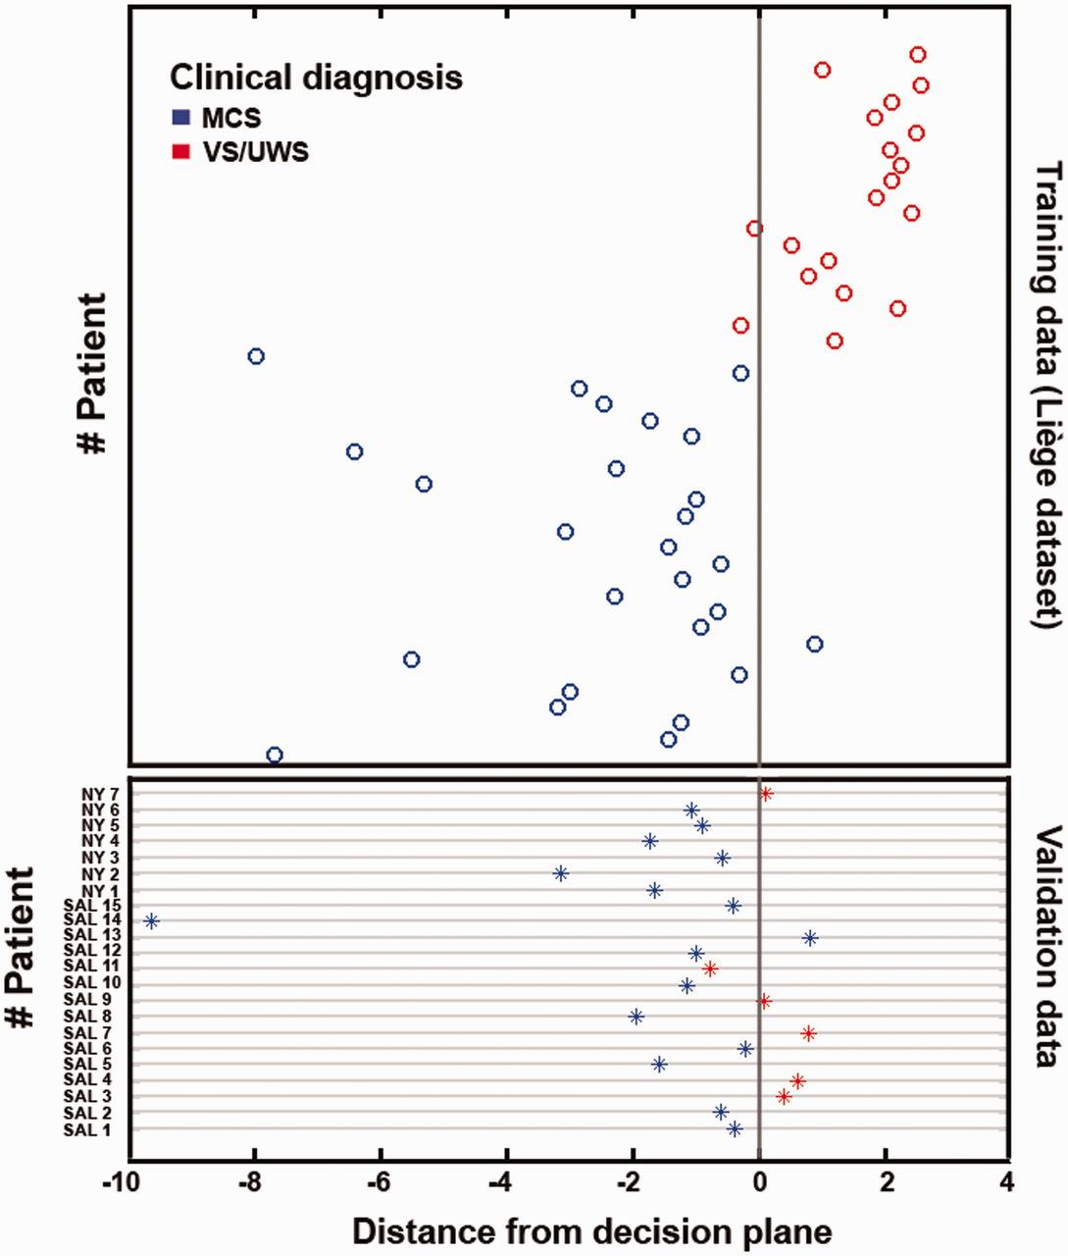
What we do: MRI analyses
N-test = 22! Why?
[1] Demertzi, Antonopoulos et al, Brain, 2015
Notes:
That’s what we did here for instance, on our population of patients with disorders of consciousness, and we found that all intrinsic/resting state networks connectivity correlate with the clinical assessment score for consciousness. We found that the most discriminating networks and the most correlated with a high consciousness score (CRS-R total score) were the auditory and visual networks. Based on these 2 networks, we made a machine learning SVM model, to discriminate between MCS and VS/UWS. One line per subject. The line is the classification decision boundaries reduced by PCA in 3D. That’s all nice, the classifier correctly discriminate almost all the patients. And the results are tested and reproduced blindly on a test dataset of subjects from other centers. Awesome! But do you see the elephant in the room? Only 22 subjects in the test/validation data! This cannot be considered a good enough sample size by any statistical standard! Why do we have so little?

Slide 4
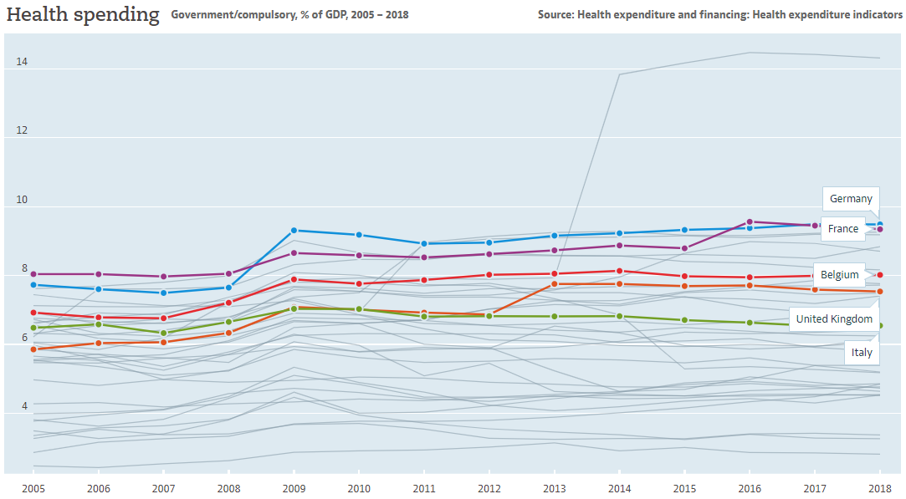
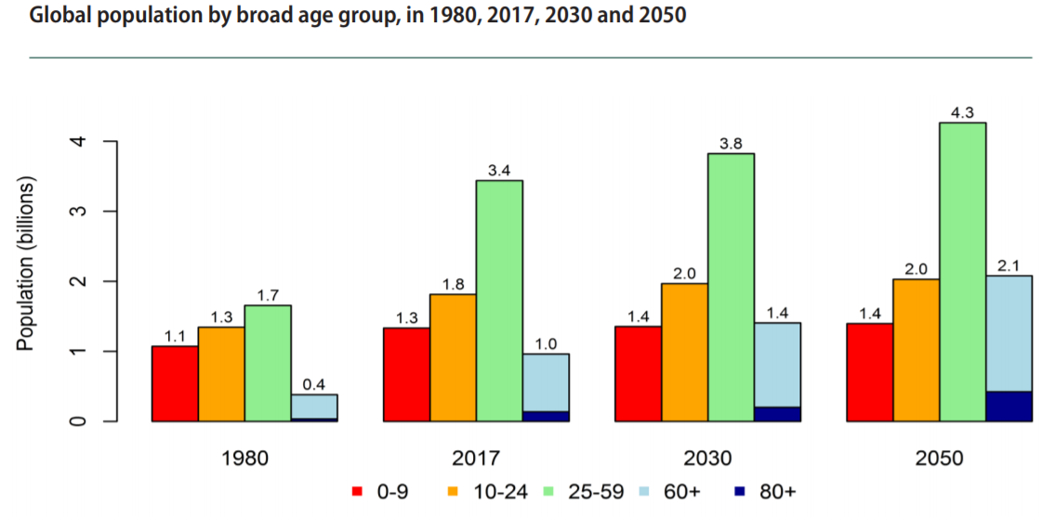
Limitations to sample size
1. Time
& Cost
Fee-for-service,
Diagnosis-related-group payment^{[4]}
[1] OECD Data 2019
[2] UN - World Population Ageing 2017 highlights
[3] Luke Allen, Conversation, 2015
[4] KCE Report 302Cs
Notes:
I wondered about this issue and tried to identify what could limit the sample size. My first idea was: why not just acquire more patients? OECD health spending: mostly stable. So all is good, right? Wrong! Because if we look at the populations evolution worldwide, there is both more and more people, and more and more aged! So to maintain the same quality of health services, the cost should mechanically increase! If it stays constant, then there is a cut in cost! This is in addition to politics that also decreases the cost superficially but not necessarily effectively such as fee-for-service, … So as you can see, we can’t increase time nor cost.

Slide 5


Limitations to sample size
1. Time
& Cost
Healthy volunteers: compliant,
cognitively autonomous
2. Motion
& Sedation
Patients: uncontrolling or
non-compliant, discomfort,
monitoring vital parameters
Admitted With MRI Analyzable Non-sedated
Over 10 years (%): 676 (100%) 465 (69%) 256 (38%) ~110 (16%)
→ Overcome limitations by optimizing acquisition?
Notes:
2nd limitation is motion & sedation, because both are linked.

Slide 6
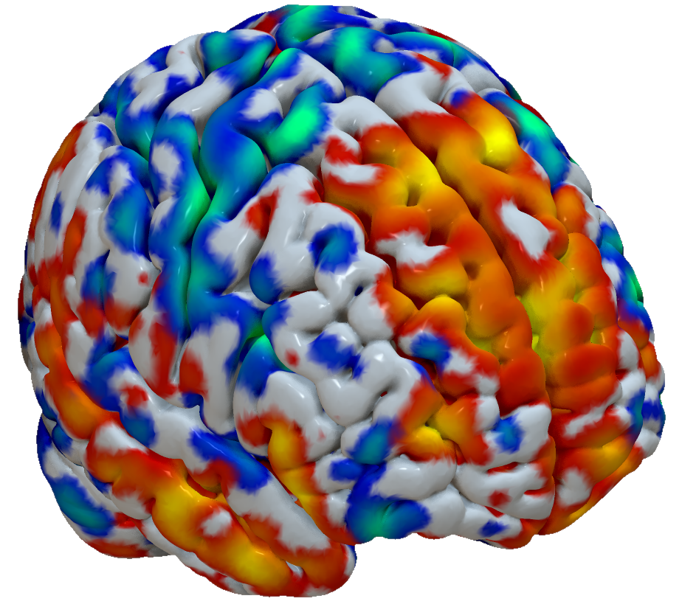
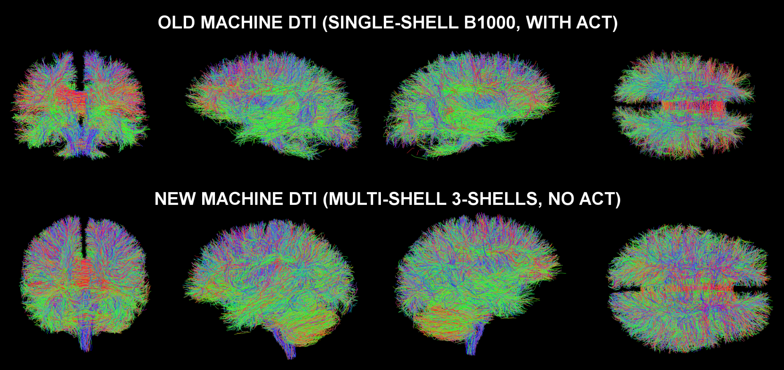
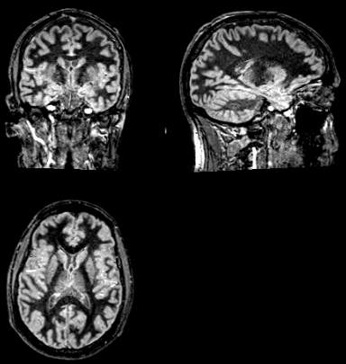
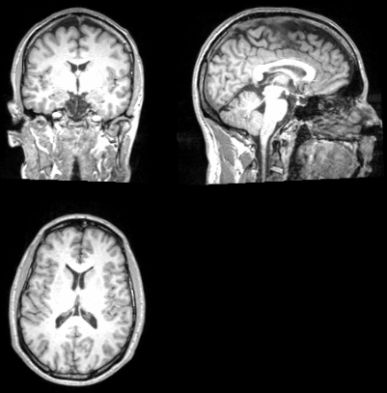
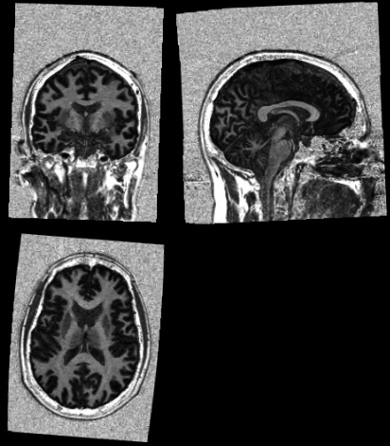
A 30 min cutting-edge, motion-resilient MRI protocol
(20-channel coil, 3T Siemens Vida)
T1 FLAWS 5:02
Sub-second BOLD
TR 728ms 500 vols in 6:13
3-shells DWI 13:25
N=35 (8 test controls, 10 stable controls, 17 patients)
Notes:
Results here are cutting edge, they are stable but preliminary results, full studies will be published once we have acquired a few more patients and controls to reach enough sample size. Hence you will mostly see first-level analyses here.

Slide 7
T1 FLAWS^{[1,2]} produces simultaneously:
White Matter
(uni)
MPRAGE
(inv2)
^{(structural, 1mm³ iso)}
→Physiological segmentation:
No approximation (not computational!)
In subject-space
Always coregistered (even with motion)
All in 5 min (on 3T), voxel size: 1mm iso
More clinical infos (complement FLAIR)
Grey Matter
(inv1)
[1] Tanner et al, 2012 [2] Yishi Wang, Hua Guo, 2018

Slide 8
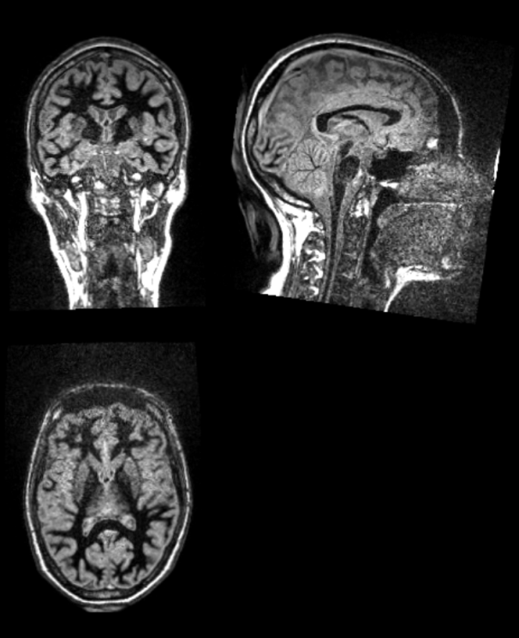
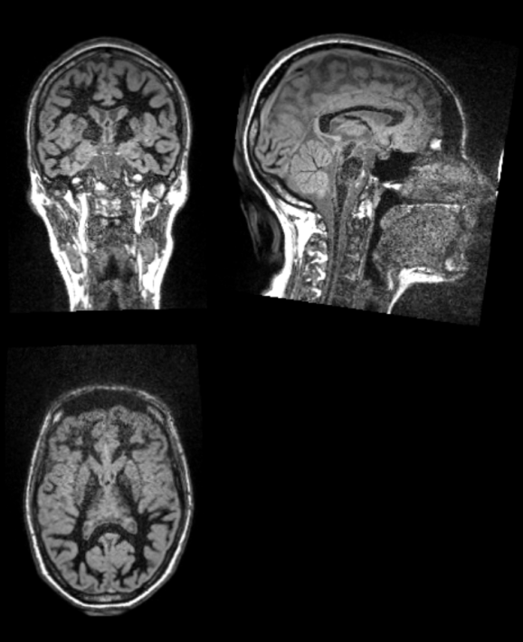
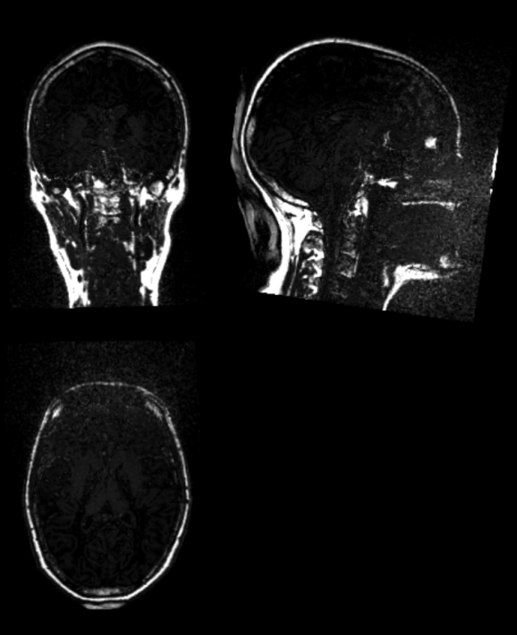
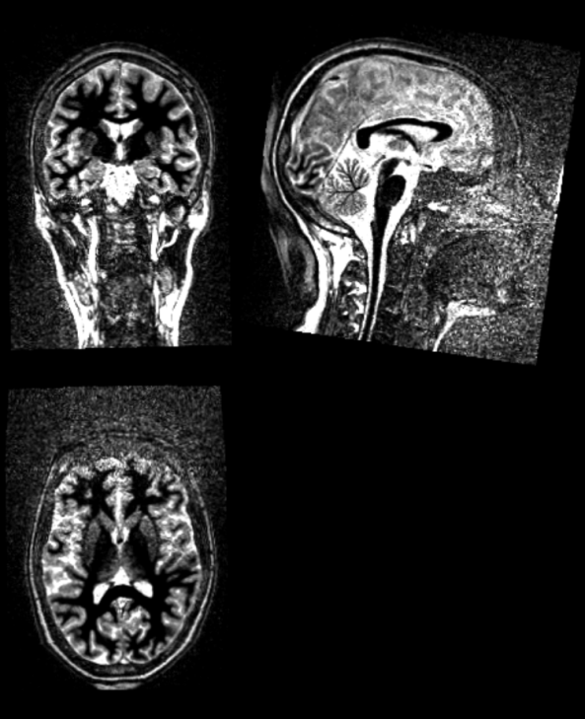
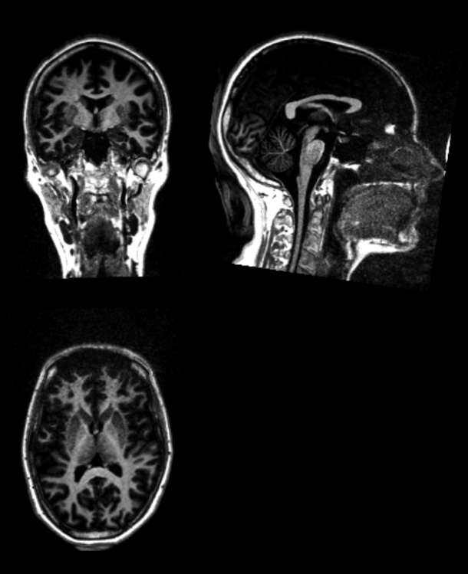
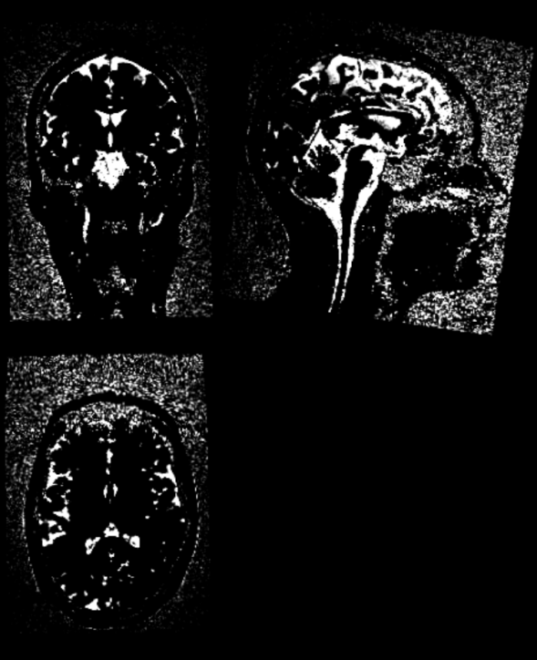
Our T1 FLAWS enhancements: (see also alternatives in ^{[1]})
GM mIP
(inv1 .* inv2) ./ (inv1 + inv2)
GM
min(inv1, inv2)
Skull
inv1 .* uni
CSF
inv1 - GM
CSF mIP
inv1 - GM mIP
WM denoised
inv2 .* uni
[1] Wang, Y., Wang, Y., Zhang, Z., Xiong, Y., Zhang, Q., Yuan, C., & Guo, H. (2018). Segmentation of gray matter, white matter, and CSF with fluid and white matter suppression using MP2RAGE. Journal of Magnetic Resonance Imaging.

Slide 9
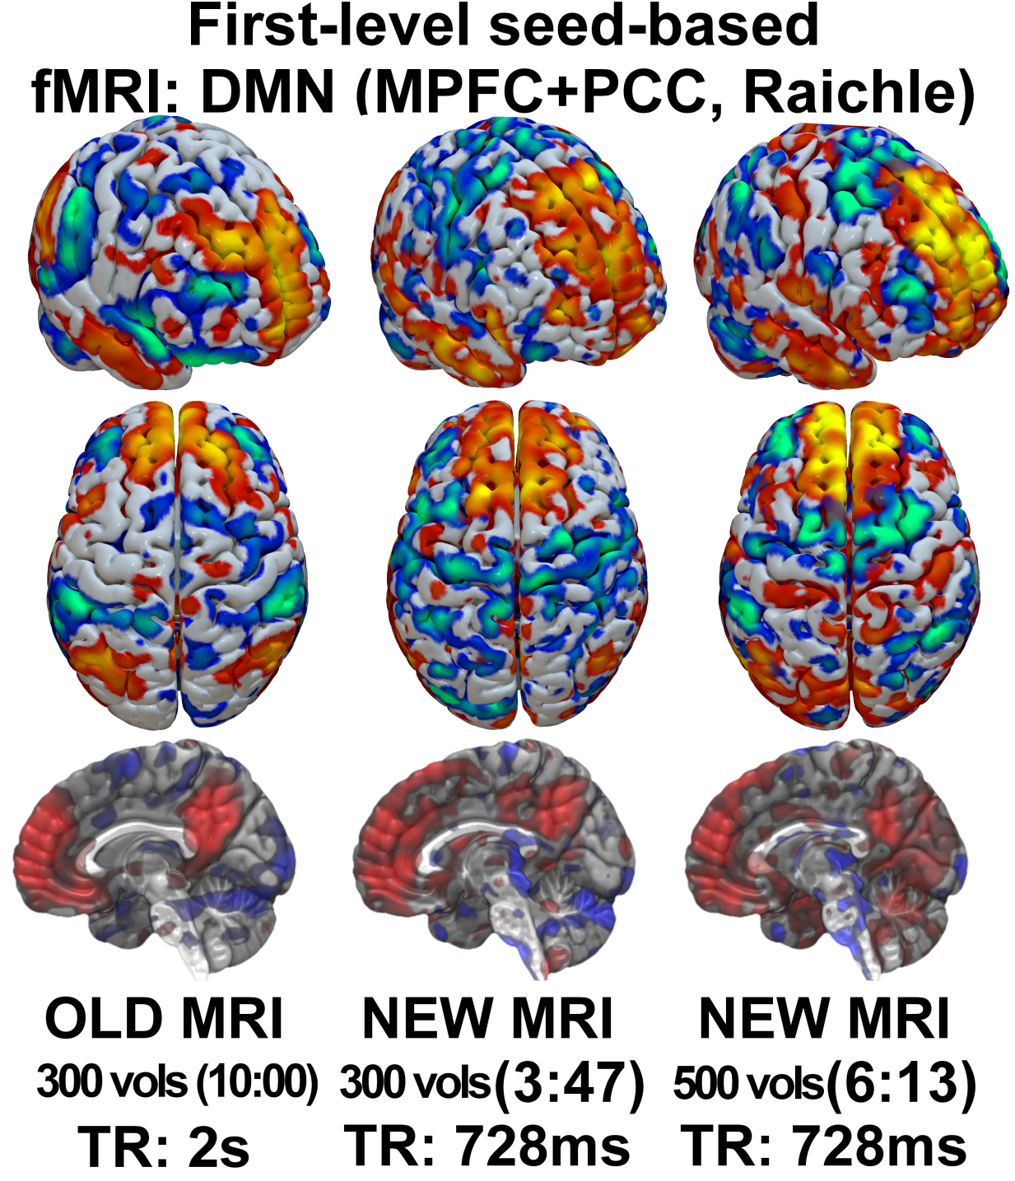
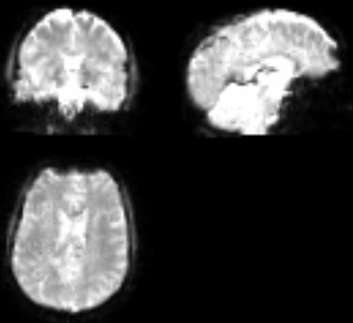
Sub-second EPI Bold fMRI (728 ms, SMS x3, PI x2, 3mm³ iso)
Dynamic connectivity
Bypass HRF (<1.5s)
Motion resilient

Slide 10
^{[1]}
2mm³ iso
Optimizations:
3 shells: b700 30dir, b1000 64dir, b2000 64dir.
b1000 is high quality (small TE), others: higher TE → faster TR.
SMS x4.
Partial fourier 7/8 (warning: prevents mrdegibbs!)
Great for:
Clinical tissue assessment under varying diffusion bvals
Worst case: degrades to single-shell
Standalone (structural unnecessary)
[1] Dhollander et al, 2016
Notes:
Can then do fixel based analysis, graph theory, etc
Note the NO ACT! No structural constraint needed anymore, it’s using … REF using only multi-shell!

Slide 11
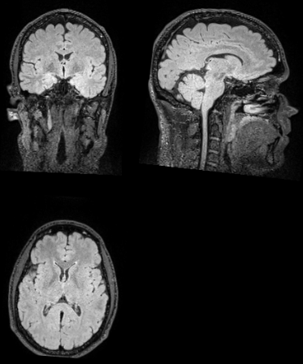
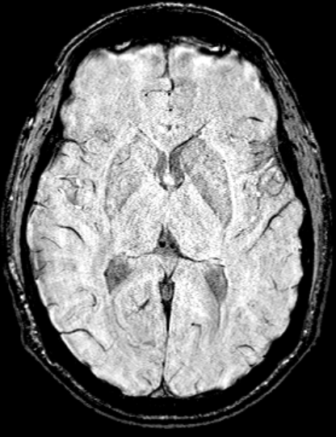
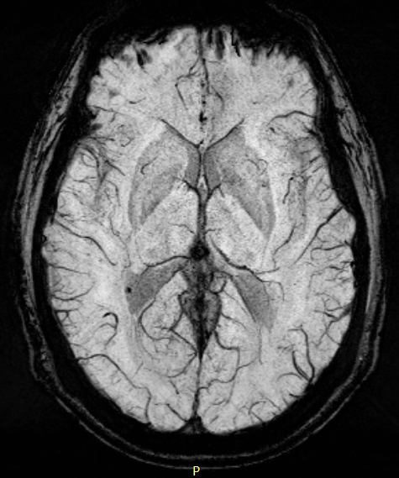
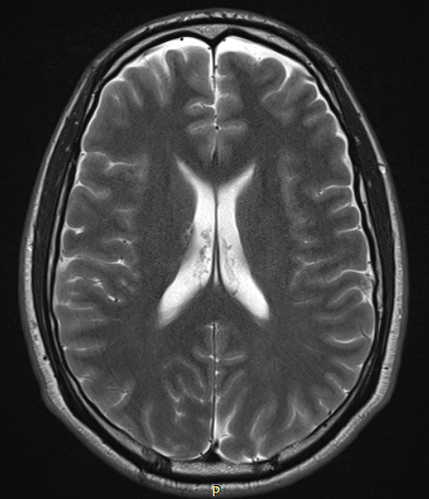
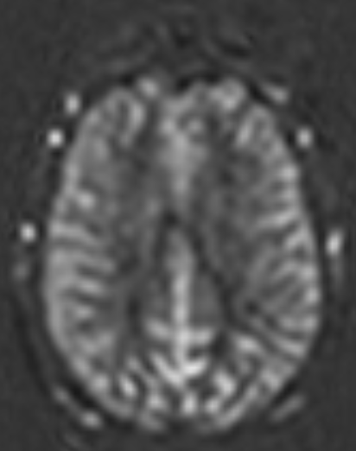
Clinical sequences: FLAIR, SWI, T2, ASL
SWI SWI/mIP 3:57, 0.6x0.6x2mm³ (with interpolation)
FLAIR 3:12, 1mm³ (with interpolation from 0.5mm²)
T2-TSE 1:21, 0.4x0.4x4.0mm³
(with interpolation)
PC-ASL 2:17, 3mm³
(with interpolation)

Slide 12
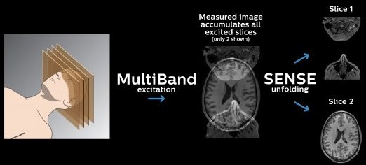
How did we make it?
Technological optimizations:
Modern acceleration: GRAPPA x multiband (SMS)^{[1]} = max x4 no loss, x6 acceptable, x8 with loss ^{[2,3,4]}
Literature MP2RAGE FLAWS, multi-shell DTI, multi-band BOLD
Fine-tuning: calculations + trial-and-error BOLD flip angle, time of inversion, bandwidth, filters, …
[1] practicalfmri.blogspot.com [2] Preibisch, Plos One, 2015 [3] Todd, NeuroImage, 2016 [4] Smith, 2018, 10.1016/j.mri.2018.06.013
Notes:
I’ll explain a bit how we did it, but feel free to consult the github repository for the full protocol, notes and bibliography.
Littérature: see end slide for a link to bibliography
Trial and error necessary because for example MP2RAGE double inversion there is no theoretical model yet. And in practice so many parameters intertwine that not everything can be calculed, some amount of trial and error is always necessary.

Slide 13
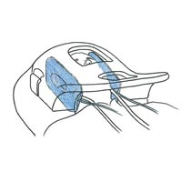
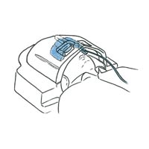
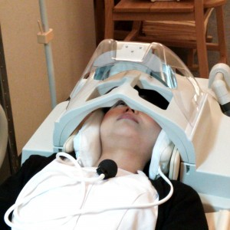
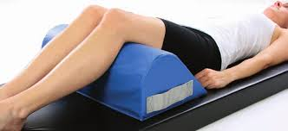
How did we make it? - 2
Meta-protocol optimizations:
Protocol programming:
Maximize speed (motion resilience, avoids sedation & reacquisitions)
Acquire BOLD first (unlikely sedated)
Conditional naming
Physical devices:
3D Head immobilizer
Comfort pillows (reduces back pain), blanket, etc.
(here: Pearltec MultiPad)
[1] Yamamura & Inatomi et al, 2018

Slide 14
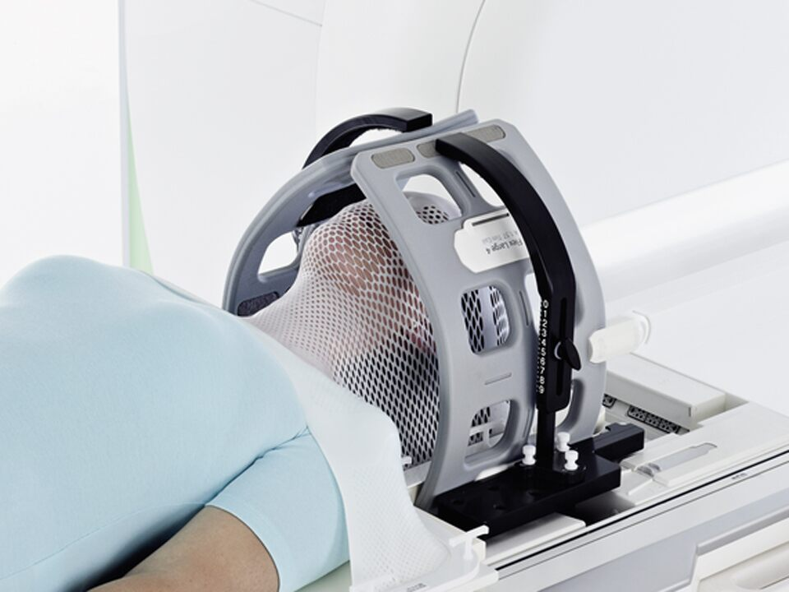
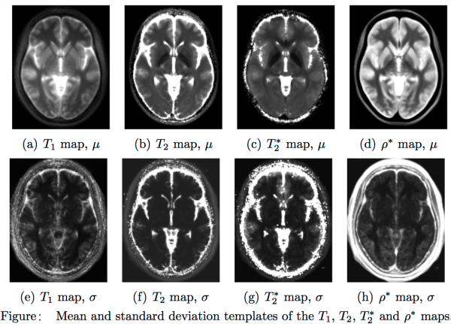
Take home message
Cutting-edge research MRI under clinical constraints possible
Quality-speed trade-off can be an opportunity
New analyses opportunities in clinical populations (dynamic connectivity, multi-tissues unconstrained DTI, …)
Reduce risks & ethical issues by avoiding sedation
Future: compressed sensing, quantitative/synthetic MRI^{[1]}, thermoplastic mask^{[2]}, AI reconstruction^{[3]}, multi-echo BOLD (ME-ICA)^{[4]}
Full protocol for Siemens Vida (need SMS license) & bibliography: github.com/LRQ3000/mri_protocol & analysis scripts: github.com/LRQ3000/csg_mri_pipelines
[1] Gonçalves, Serai, Zuccoli, 2018 [2] Mandija, Agata et al 2019 [3] Bo Zhu et al, Nature, 2018 [4] Dipasquale et al, 2017
Notes:
I hope I have convinced you that it’s possible…
Sufficient quality: of course, we still have the speed-quality trade-off, even if we pushed it a bit further with the new technologies, if we had more acquisition time we could of course have more quality/resolution etc, but the point is that we can still have cutting-edge
Experiment: It’s not black magic! (although it looks like that sometimes), and you can have huge gain, all you need to do is trial and error on a dummy or a healthy volunteer (under supervision of radiologists or MRI provider specialist)

Slide 15



Thank you for your attention!
github.com/LRQ3000/mri_protocol
Basic analysis scripts: github.com/LRQ3000/csg_mri_pipelines
Huge thanks to Jean-Marc Léonard at Siemens Healthineers and to Jean-Flory Tshibanda, Gauthier Kempinaire, Nathalie Maquet and the Liège Hospital’s Radiodiagnostic team and Pearltec for their support!

Slide 16
Bonus slides

Slide 17
MRI: the time-quality conundrum
Great polyvalence, for both research and clinical purposes
Wide array of imaging contrasts: structural/function anatomy/connectivity, blood flow, lesions, etc.
But clinical vs research needs are different:
Limited acquisition time (30 to 60 min) vs virtually unlimited (2h+)
Clinical pertinence (eg, lesions) vs cutting-edge (multi-shell DTI)
Uncooperative/uncontrolling patients (motion, discomfort, panic!) vs healthy volunteers (instruction compliance, no motion, calm)
Usually results in a compromise: most sequences are clinical, some are for research with sub-optimal outdated (but faster) parameters
→ Can we make a MRI protocol both with cutting-edge research sequences and under clinical constraints?
Notes:
30 to 60 min → in fact the lesser the better!
Little intro story with pictures?
Show old and new machines (opportunity to introduce the machines names)
Or the story can be for next slide, the time-quality conundrum

Slide 18
How did we make it?
Technological optimization:
Modern acceleration technologies: GRAPPA parallel imaging + simultaneous multi-slice (SMS aka multi-band). Beware of speed-quality trade-off!
Literature for base sequences (MP2RAGE FLAWS, multi-shell DTI, multi-band BOLD)
Calculations + trial-and-error to fine-tune parameters (BOLD flip angle, time of inversion, bandwidth)
Notes:
Littérature: see end slide for a link to bibliography
Trial and error necessary because for example MP2RAGE double inversion there is no theoretical model yet. And in practice so many parameters intertwine that not everything can be calculed, some amount of trial and error is always necessary.

Slide 19
How did we make it? - 2
Meta-protocol optimization:
Careful protocol programming:
Maximize speed of sequence acquisition (reduces risk of motion and need for sedation)
Place BOLD first, structural/rest after (ensures patient is awake, less distressed, always guarantees a non-sedated BOLD)
Sequence renaming depending on choices (eg, sedated or not?) for automatic documentation stored in DICOMs (bypass lack of conditional custom data storage in MRI software)
Physical devices:
Head immobilizer
Comfort knee pillow (reduces back pain), blanket, etc.

Slide 20
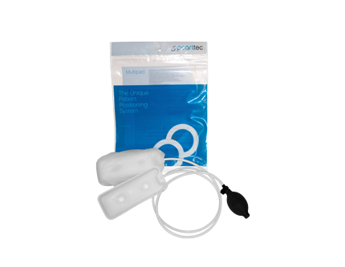
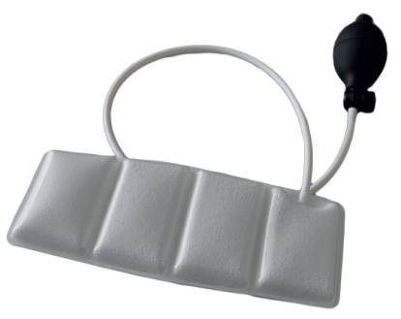
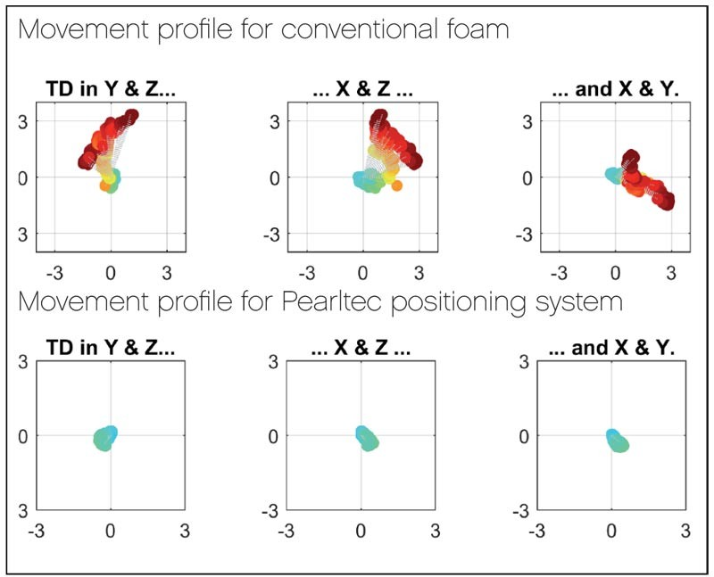
Inflatable 3D head immobilizer
Reduces:
motion artifacts
need for sedation
(see infants studies, eg, Yamamura & Inatomi et al, 2018)
(here: Pearltec MultiPad)

Slide 21
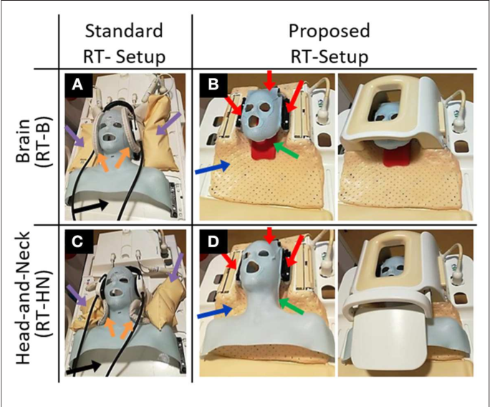
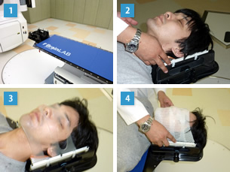
Future:
Thermoplastic masks?
(Mandija, Agata et al 2019)
Notes:
Thermoplastic mask, so it solidifies! Although probably the most efficient method, let’s say we’re not sure it’s totally OK with patients who already have difficulties to express consent. There is a very recent study that shown that this method is quite efficient at eliminating head motion with equal efficiency as sedation (thus we don’t need sedation anymore), and we can well believe so. Now let’s look at what it looks like in practice with a similar but more industrialized model.
From an outsider’s point of view, it can look like a bit crazy heh, like a bad horror movie where the physician would be trying to suffocate the patient! ;-) Of course that’s not the case, and it’s a very good setup stabilizing the whole head, but it’s understandable that a patient who’s not cognitively autonomous may not like or understand such a procedure, and that’s an euphemism.
Inflatable pillows look for us like a good compromise between discomfort and movement reduction.
RT Pro Siemens

Slide 22
Additional advices
Enable 3D distortion correction, for all!
Use alternate streams, allows to save non distortion corrected versions at no cost!
Enable Prescan Normalize for better contrast (eases coregistration) on all sequences
Disable other filters (Hamming, frequency/smoothing, etc)
Disable PACE (prospective motion correction), as this prevents retrospective motion correction (ie, with external softwares such as ART)
If lots of Gibbs noise (eg, in FLAWS or MP2RAGE), lower GRAPPA acceleration!
For multi-shell DTI, acquire 3 different DTI sequences and bundle together with a Copy Reference to copy the acquisition parameters automatically (necessary for the multi-shell DTI to be valid)

Slide 23
Additional advices
With uncooperative/uncontrollable populations, the speed-quality trade-off might be simpler: better to speed up and have a more stable (but lower resolution) image, than have a high-resolution image that fails most of the time to be acquired because of motion!
Acquire with interpolation and rescale, eg: acquire at 0.5x0.5x1.0mm and rescale to 1.0mm³, slight increase in SNR
Increasing bandwidth reduces susceptibility to metal and chemical artifacts, useful for patients with potentially blood or metal infarcts

Slide 24
About free experimentation
Feel free to experiment with your protocol, often the sequences are not optimized for your machine and/or needs.
How to proceed: no necessary need for calculations, trial and error is still the best approach (use bisection approach), but where available, calculations can save you some time instead.
Try on a dummy or a healthy volunteer, under supervision from radiologists or MRI brand engineer to ensure no risks notably of tissue over-heating (SAR). Normally most modern machines implement safeguards that should in any case prevent these issues by warning the operator and change adequately the protocol.

Slide 25
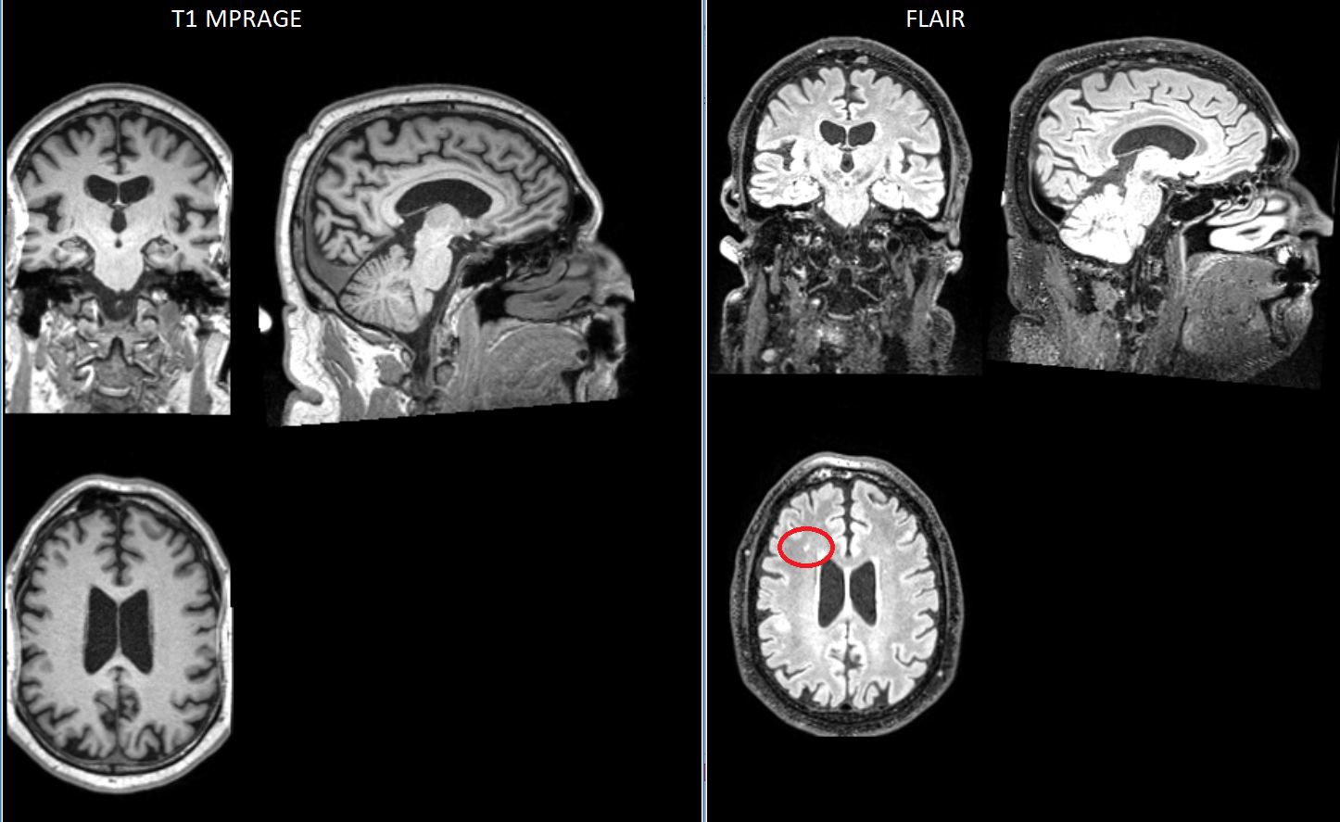
Clinical T1 FLAWS vs FLAIR
Infarct invisible on T1 MPRAGE! But is visible on FLAIR

Slide 26
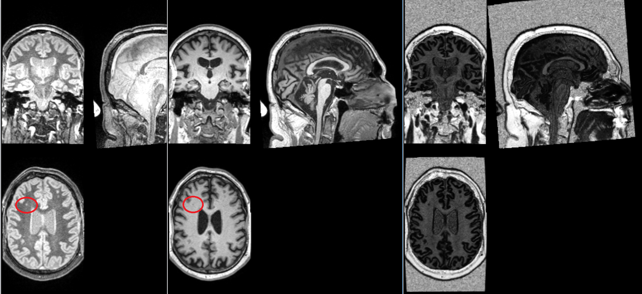
Clinical T1 FLAWS vs FLAIR
However, with FLAWS, the infarct is visible on the other contrasts generated simultaneously with the MPRAGE! Thus can complement/replace FLAIR in some instances. In addition, the 3rd image confirms that the infarct is in the white matter.

Slide 27
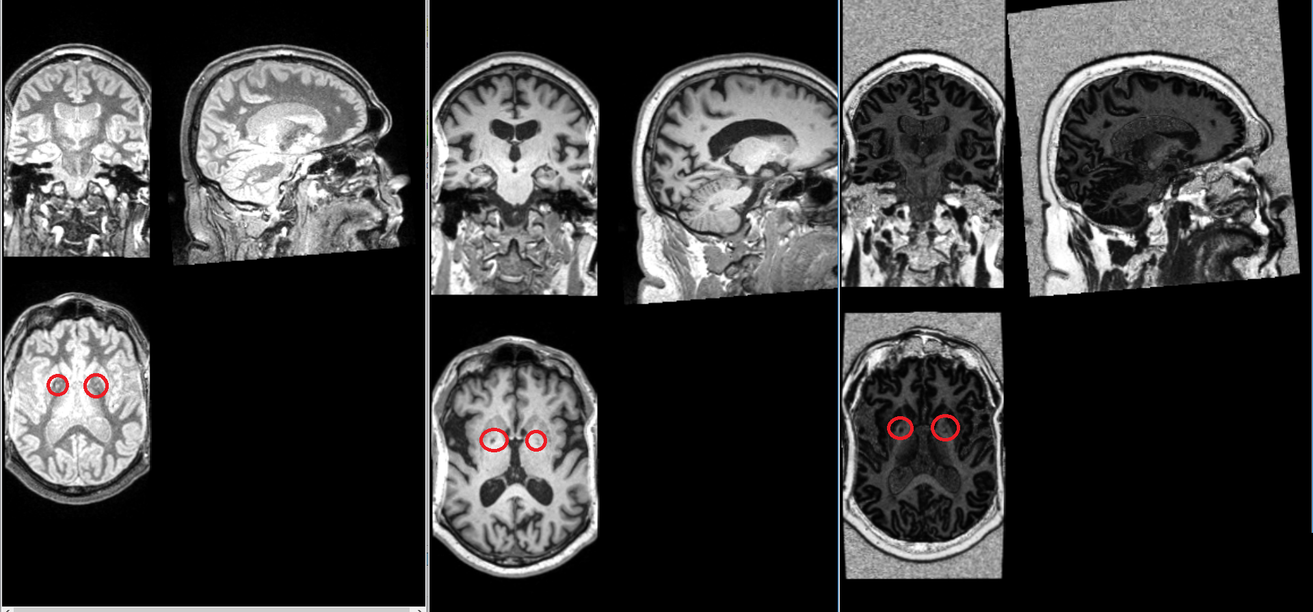
Clinical T1 FLAWS vs FLAIR
Two other infarcts of the same subject. The 3 contrasts of the FLAWS allows to confirm that the infarcts are located in the white matter.
See also: Enhanced visualization of lesions in focal cortical dysplasia using the fluid and white-matter suppression (FLAWS) sequence, Xin Chen, Tianyi Qian, Tobias Kober, Nan Chen, and Kuncheng Li, ISMRM 2017, http://indexsmart.mirasmart.com/ISMRM2017/PDFfiles/2331.html

Slide 28
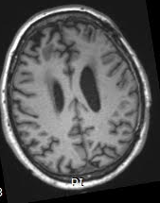
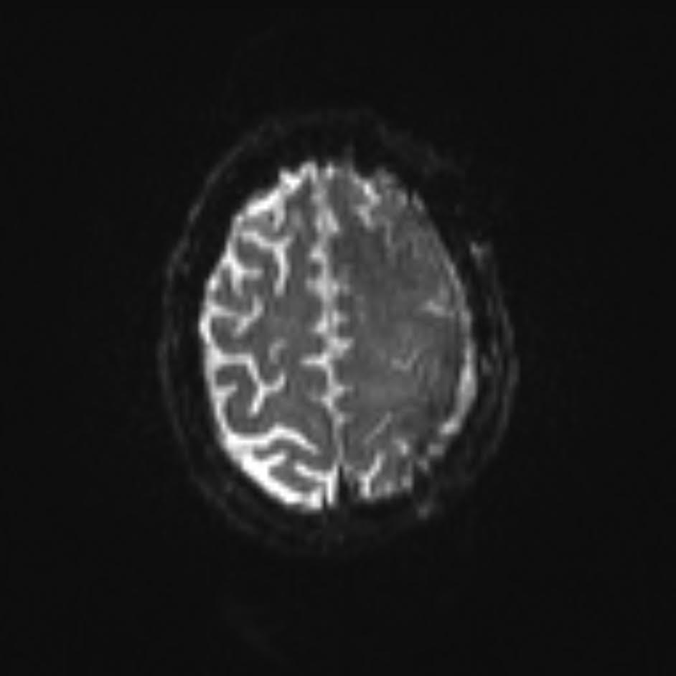
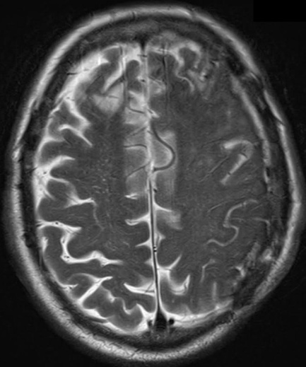
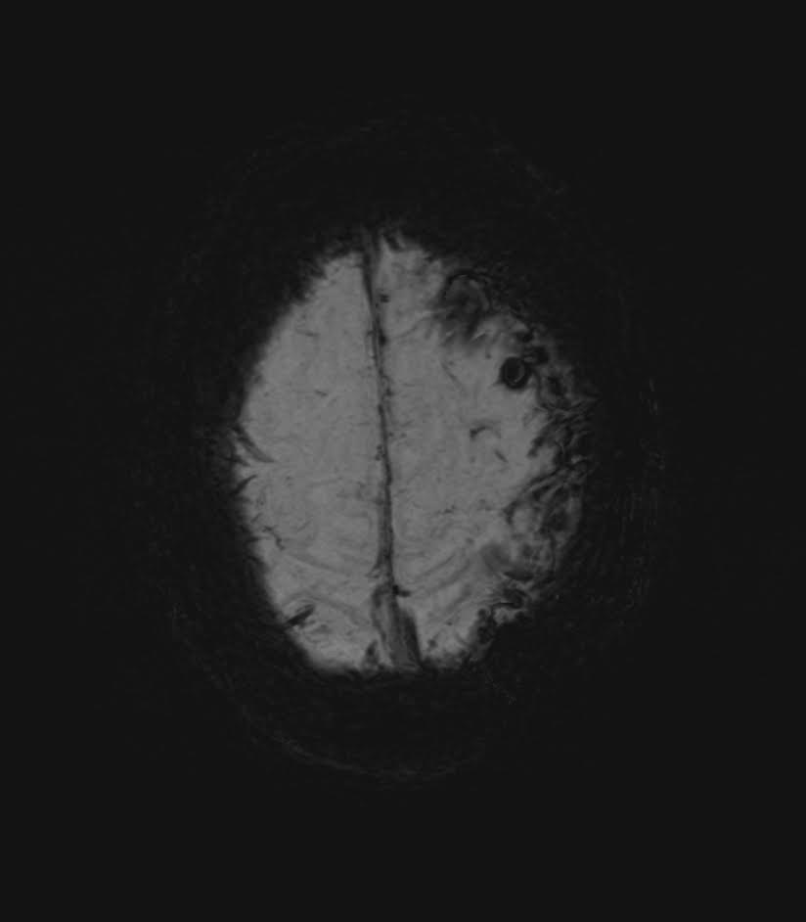
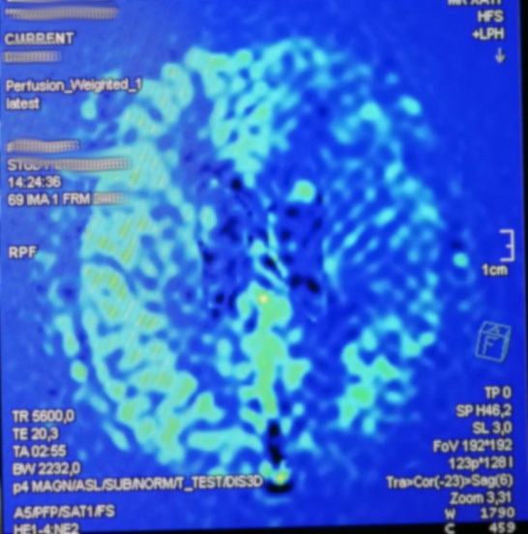
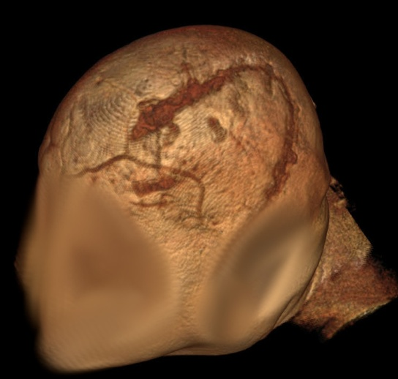
Better clinical assessment by combining modalities
MPRAGE
FLAIR
T2
SWI
PC-ASL
high resolution
Patient’s craniectomy led to a decrease of vascularity and CSF fluid, only visible on FLAIR, T2 and PC-ASL, but not on MPRAGE nor SWI.
Can potentially impact HRF and thus PET and fMRI results.

Slide 29
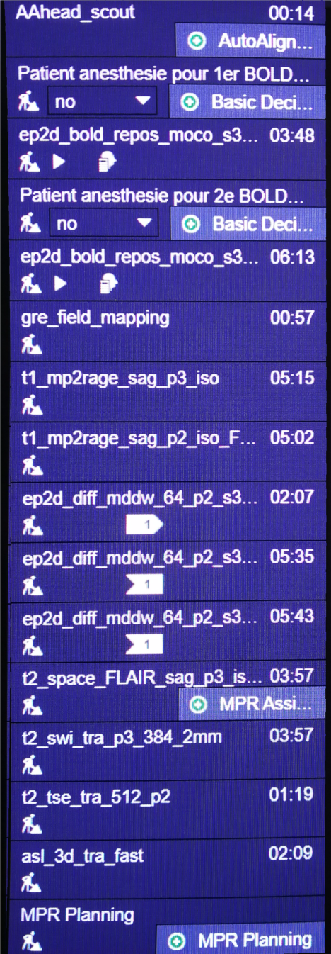
MRI protocol decisions walkthrough (20-channel coil)
Short BOLD 3min47: Non-sedated! (except if really problematic patient)
Better have motion than sedation! (we can correct motion, but not sedation!
Might be sedated if necessary, but please avoid
Structural: Sedation OK!
Note: If sedated, please choose « yes » in the boxes highlighted here in red.
Please do not delete or replace any sequence!
(Sequence name will change according to sedation decision set here)
Note2: 3 DTI sequences go together via a Copy Reference ALWAYS!
If you need to redo DTI, please redo all three!
All sequences can be implemented on any 3T Siemens
with multiband and MP2RAGE support (here Vida)

Slide 30
MRI protocol sequences list
1. AAhead_scout
2. Decision: Patient anesthetized?
Yes: ep2d_bold_repos_moco_s3_p2_long_avec_AG
No: ep2d_bold_repos_moco_s3_p2_long_sans_AG
gre_field_mapping
3. gre_field_mapping
4. t1_mp2rage_sag_p2_iso_FLAWS_fast
5. ep2d_diff_mddw_30_p2_s4_b700
6. ep2d_diff_mddw_64_p2_s4_b1000
7. ep2d_diff_mddw_64_p2_s4_b2000
8. t2_space_FLAIR_sag_p3_iso
9. t2_swi_tra_p2s2_ir_2mm
10. Decision: Acquire PC-ASL?
Yes:
pcasl_3d_tra_p2_iso_3mm_highres_fast
No: Stop.
→ 20 channels coil but also possible with 64 channels!

Slide 31
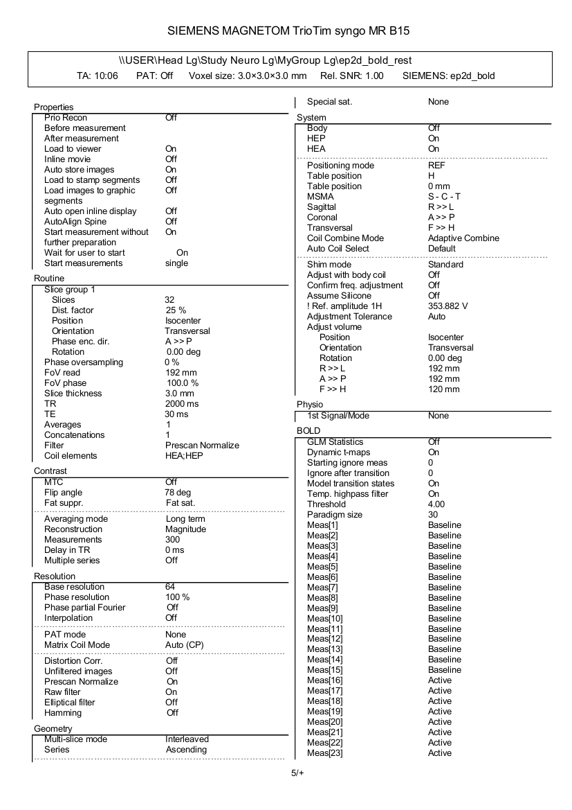

Slice order: check in the machine’s printout!
This « interleaved » means nothing!
Ascending = sequential ascending. Else it would be «interleaved » here for interleaved ascending.

Slide 32

QA image example (same subject)

Slide 33

QA image example (same subject)

Slide 34

Multi-shell DTI

Slide 35
Typical fMRI processing steps
Select subjects, prepare demographics (age, gender, etiology, sedation, etc)
Convert from DICOM to NIfTI
Exclude bad subjects (too much motion, artifacts, brain surgery, metallic prosthesis, etc)
T1 reorient
EPI/DTI manual coregistration
Slice timing correction
Realignment (motion correction)
Auto coregistration
Segmentation + Normalization (MNI 152)
Smoothing
Movement correction/rejection
Denoising (PCA aCompCorr, ICA, etc.)
Manual
Takes > 90%
of the
analysis time!
Automatic (mostly)

Slide 36

spm_auto_reorient_coregister:
Enhanced automatic reorientation and coregistration
on brain damaged patients with SPM12
94% success rate
(11 totally off, 17 slightly
over 434 sessions, 410 subjects)
https://github.com/lrq3000/spm_auto_reorient_coregister
Notes:
Tested on 100 more subjects and about 400 more sessions with similar results!

Slide 37


